Slide 1


Accomplished
Finished the loop A behavior simulation.
The simulation result is on the next few slides.

Slide 2
Structure
Ctrl Logic
Pooling
Global buffer
Ifm_addr_gen
Accumulator
Ifm_matrix_buf
Img2col_ifm
Ifm_buf
wgt_matrix_buf
Img2col_wgt
Wgt_buf

Slide 3
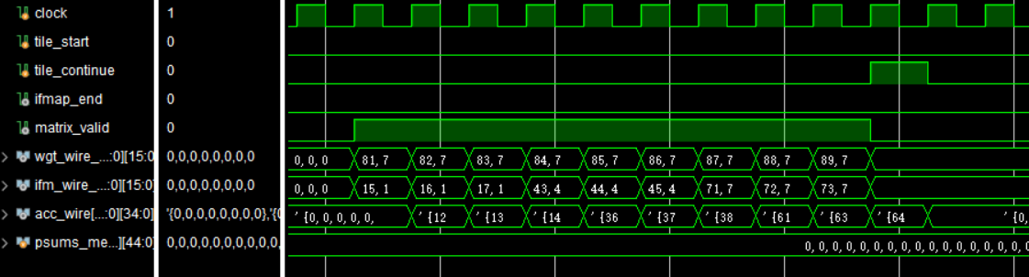
Picture 1

Slide 4
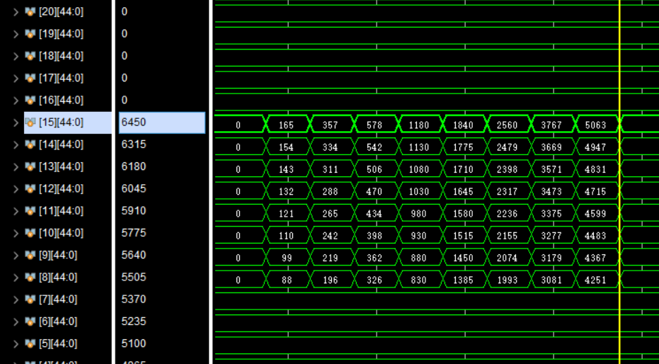
Picture 2

Slide 5
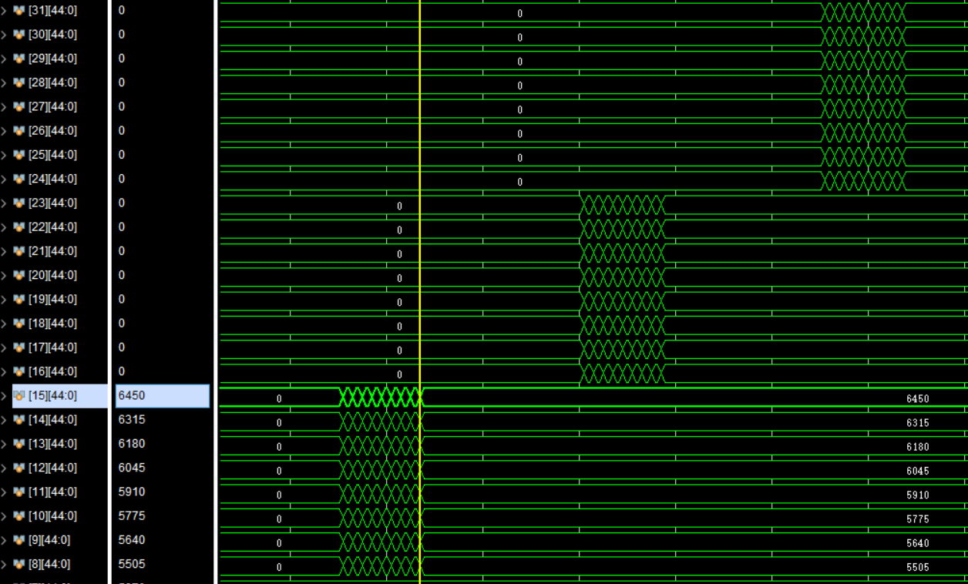
Picture 3

Slide 6
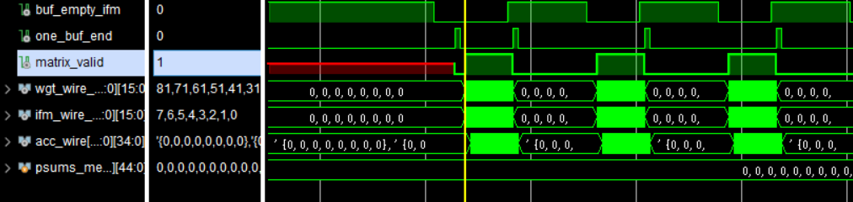
Picture 4
total:250ns/10ns idle:160ns/10ns busy:90ns /10ns

Slide 7
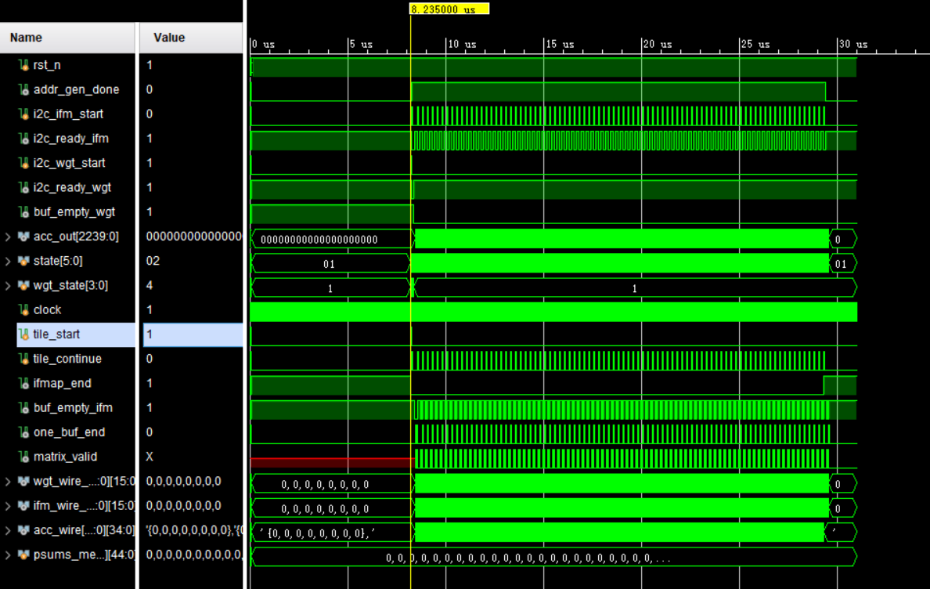
Picture 5

Slide 8
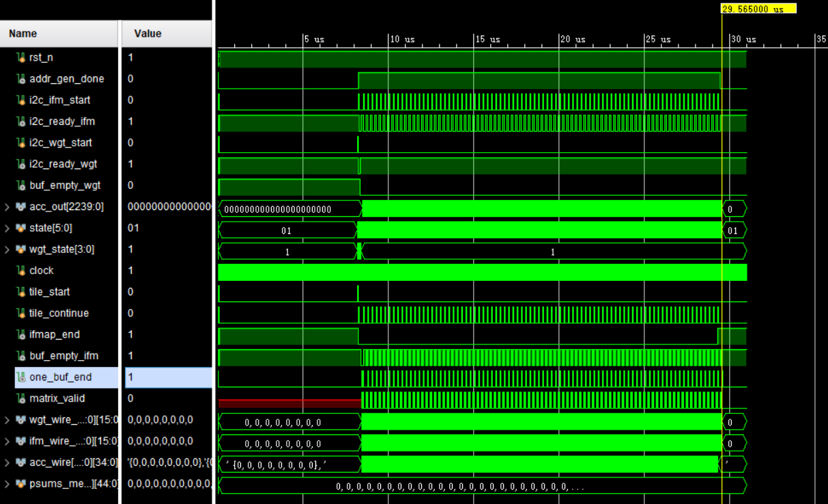
Picture 6

Slide 9
Efficiency
one 28*28 tile, 8 channels, 512 multipliers
total: 21330ns/10ns
ideal time: 26*26*9*8÷512=96 cycles

Slide 10
Plan
1. Write the pooling module;
2. Improve the convolution efficiency.

